Slide 1
Predicting Homeownership Through Machine Learning
by Eric Fecke, James Mills,
Myla Moore, and Trey Bickham
Notes:
Trey
A recent logistic regression analysis on 23-year-old data (Letkiewicz & Heckman, 2018) analyzed various predictors of homeownership among a sample of approximately 1,000 households.
Considering that 2 major economic recessions have occurred since the time of the collection of the data in the Letkiewicz and Heckman (2018) study, the present study advances the research in the prediction of homeownership, especially by using data collected after the two major recessions of the 2000s (e.g., Kim & Chen, 2020), increasing the sample size by nearly 10 times, and partitioning the data set into training and validation partitions in an effort to downplay the effects of overfitting the predictive model.

Slide 2
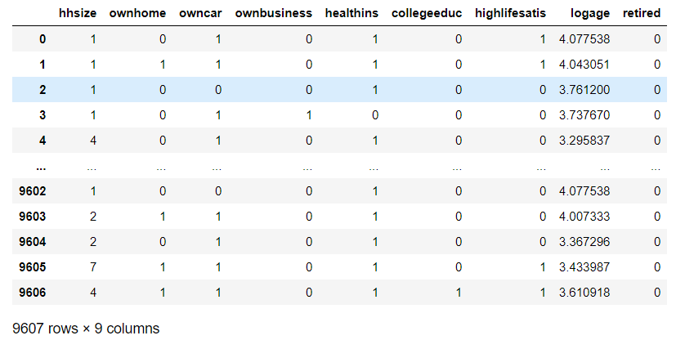
Overall Dataframe (n = 9607)
Notes:
Trey
Therefore, given that we are working a cross-section of survey data, our success is defined as being able to predict homeownership or non-homeownership more accurately than 50%-50% in context following the two major recessions.
Our data come from the 2017 Release of the Panel Study of Income Dynamics, conducted every other year on the same households by the Institute for Social Research, Survey Research Center, at the University of Michigan.
n = 9,607 but this was subsequently and randomly split into a 70% training (n = 6,724) and 30% testing (n = 2,883) partition.

Slide 3
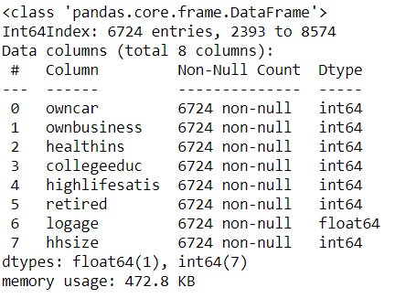
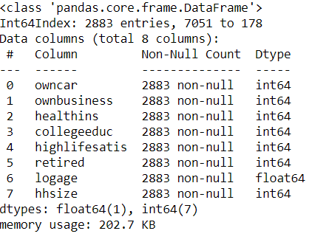
Training-Test Split
Training Partition n = 6,724
Test Partition n = 2,883
Notes:
Trey
n = 9,607 but this was subsequently and randomly split into a 70% training (n = 6,724) and 30% testing (n = 2,883) partition.

Slide 4
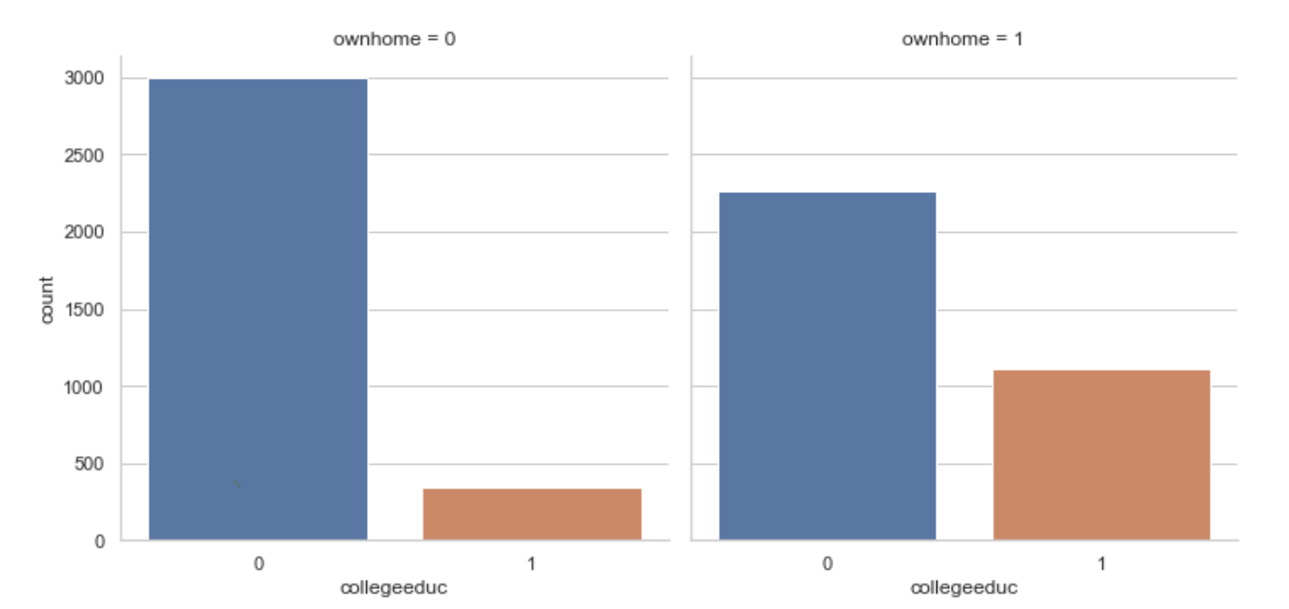
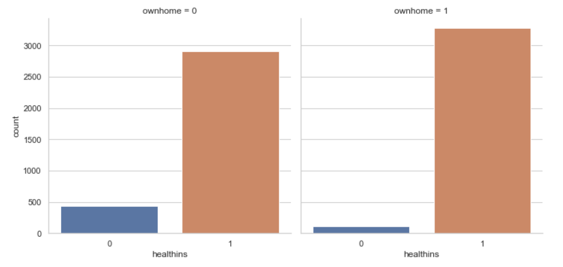
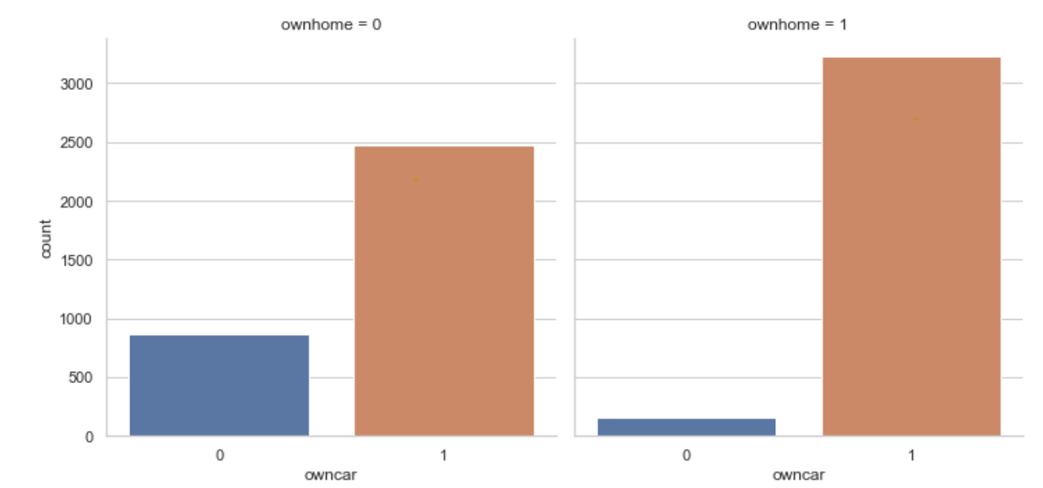
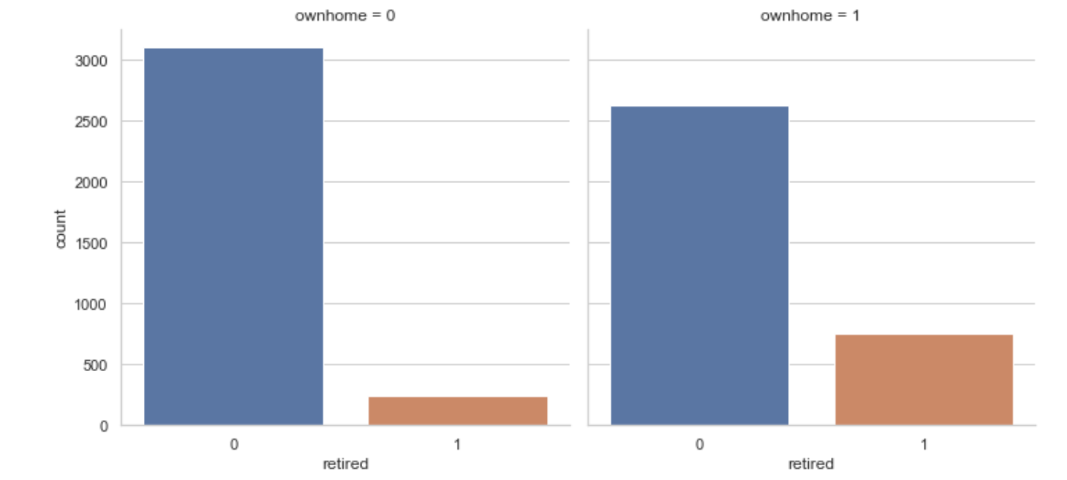
Target Features
Notes:
Myla
Outcome Variable: Homeownership, a dichotomous variable where 1 denotes homeownership, 0 otherwise.
6 Dichotomous Predictor Variables: Coded as one for the presence or espousal (zero for the absence) of the following socioeconomic characteristics of the households: car ownership, business ownership, health insurance, any college education from an Associate’s degree through a Doctoral degree, whether the head of the household was retired, and high life satisfaction (responding as completely satisfied or very satisfied with one’s present life conditions).
2 Continuous Predictor Variables: Household size, operationalized as the number of people (including the head of household) in the respondents’ house, and the natural log of the head of household’s age.
Talk about why we dropped familyid', 'age', 'dwellingunit', 'employmnt', 'RELEASENUMBER', 'salaryamnt', 'age2', 'worknow', 'numbercars'

Slide 5
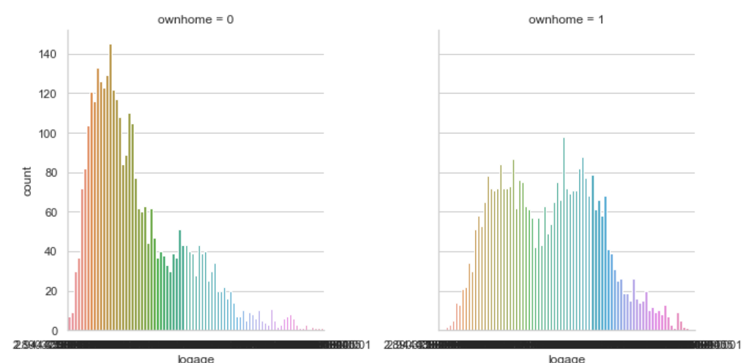
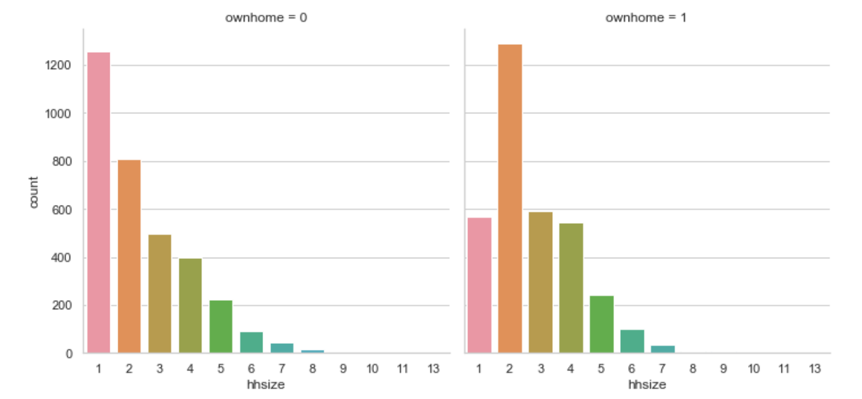
Data Wrangling
Notes:
Myla
In comparison to the data utilized in the Letkiewicz and Heckman (2018) study, our project assumes that two major economic recessions had taken place already, with the most recent being the recession of 2007 and 2008. This also includes an assumption that our survey sampling frame had approximately nine to ten years to financially recover from the most-recent recession, given that our data were collected in 2017. We also assume that our survey participants answered completely and honestly.
The project also assumes that the data were normally distributed. In fact, one of our variables, the natural logarithm of the household head’s age, is a log transformation of a raw age variable in order to render this variable normal.

Slide 6
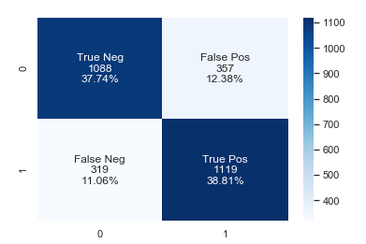
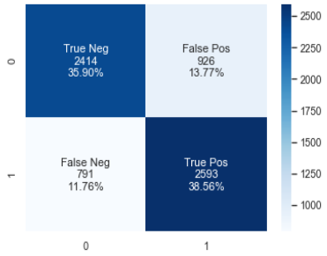
Logistic Regression
Training Confusion Matrix
Test Confusion Matrix
Prediction Accuracy
76.55%
Prediction Accuracy
74.46%
Notes:
Eric
Displaying the confusion matrix for each the test and training.
For the training set, the total of true positives (those correctly classified as yes) and true negatives (those correctly classified as no) was 5007 out of 6724 observations (74.46%).
For the test set, the total of true positives (those correctly classified as yes) and true negatives (those correctly classified as no) was 2207 out of 2883 observations (76.55%).
The model is a more than capable predictors, staying within .03 of each other in regards to the confusion matrices.

Slide 7
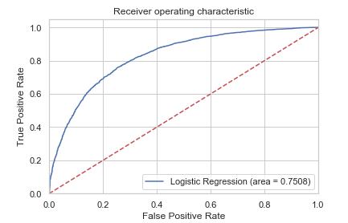
Logistic Regression (cont.)
Notes:
Eric
In previous classes, we found that the ROC curve was a great way to measure logistic regression accuracy. The closer to 1, the better the model, and this ROC curve is pretty solid.

Slide 8
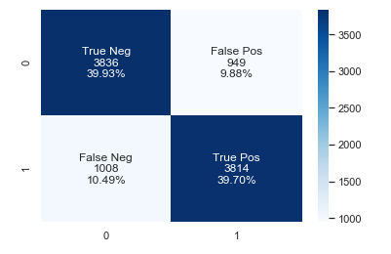
Random Forest
Confusion Matrix
Prediction Accuracy
.7963
Notes:
Eric
Displaying the confusion matrix for the random forest set.
For the training set, the total of true positives (those correctly classified as yes) and true negatives (those correctly classified as no) was 7650 out of 9607 observations (79.63%).
The model is effective as a predictor.

Slide 9
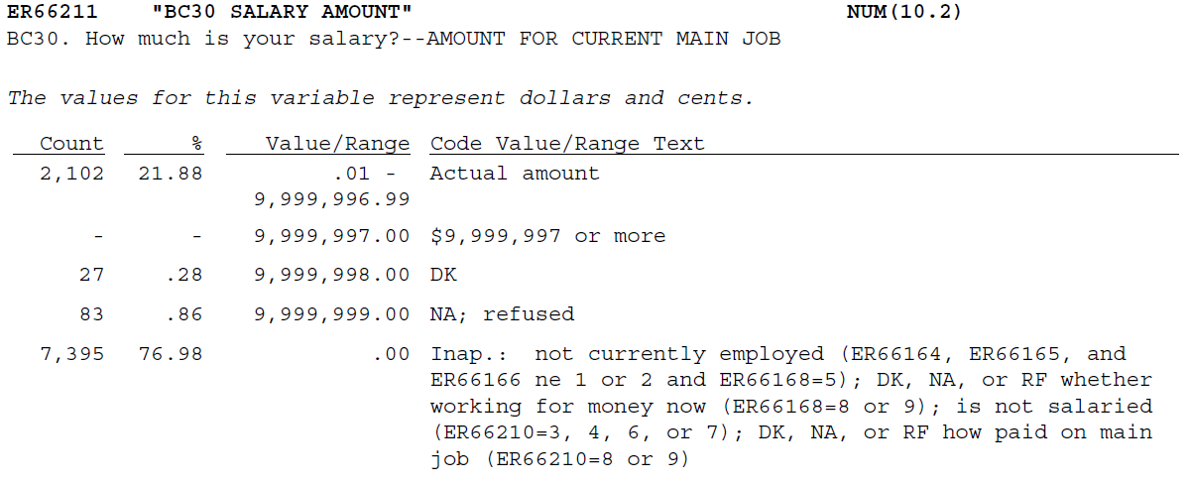
Surprises and Limitations
Notes:
James

Slide 10
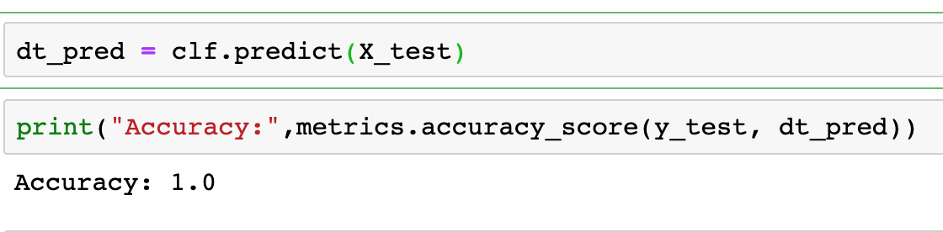
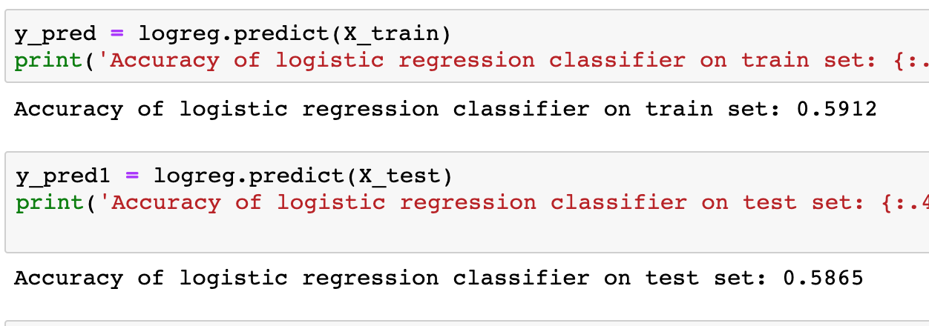

What Worked and Did Not Work
Neglecting to specify our independent and dependent variables
Notes:
James

Slide 11
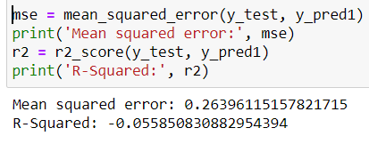
What Worked and Did Not Work
Requesting MSE and R^2 for a decision tree for a dichotomous dependent variable
Notes:
James

